Slide 1
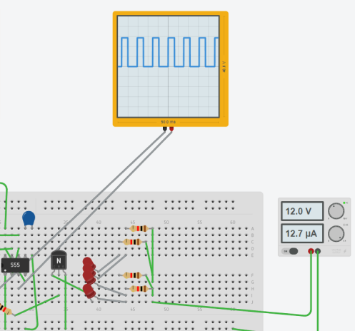
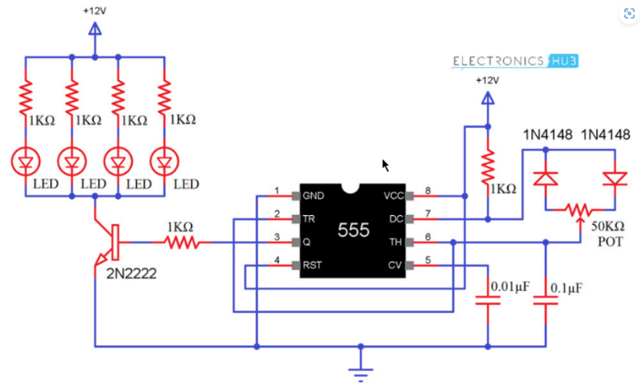
PART 2: CIRCUIT WORKING PROCESS
After getting Pulsating Voltage output from 555
A current passes through BJT because of resistance
Faces LED Diode Cathode (-) and Anode (+) terminals
Voltage at Cathode HIGH — LED OPEN- LIGHT OFF
When V(-)>V(+)----OPEN
When Voltage at Cathode terminal is LOW:
DIODE INSIDE LED IS SHORT
LIGHT TURNS ON
BECAUSE When V(-)<V(+) DIODE IS SHORT
SHIHAB MUHTASIM

Slide 2

Results Observed in the hardware Lab
03
SHIHAB MUHTASIM

Slide 3
TEST CASES
CASE 1
CASE 2
CASE 3
LOW BRIGHTNESS
AVERAGE
BRIGHTNESS
FULL BRIGHTNESS
LED stays ON for less time and it’s OFF for more amount of time.
LED stays ON and OFF for about equal amount of time.
LED stays ON for more time and it’s OFF for less amount of time.

Slide 4
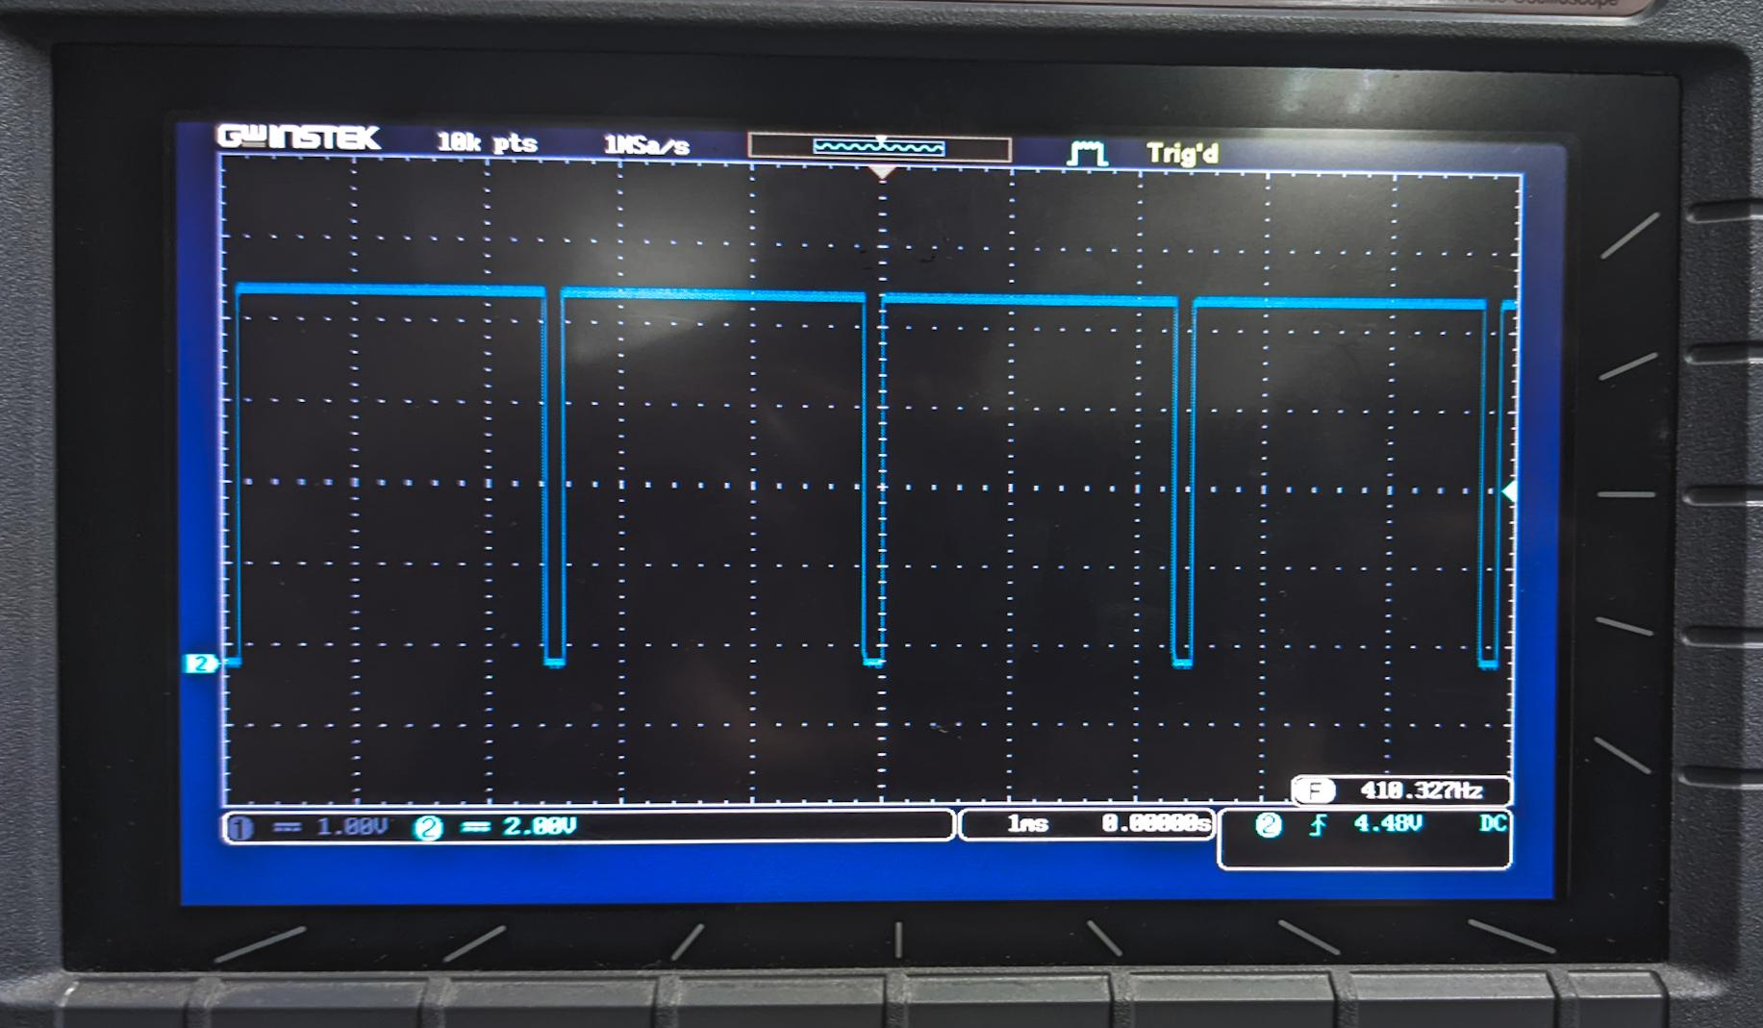
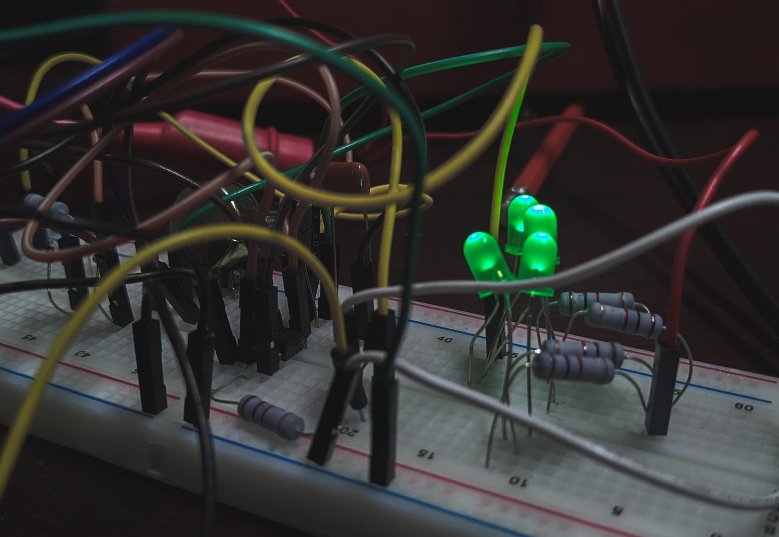
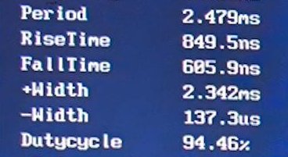
CASE 1
LOW BRIGHTNESS
When 2.3 ms time High voltage out of 2.47 ms T
Diode is OPEN
LED is OFF
When 137.3 us time Low voltage out of 2.47 ms T
Diode is SHORTED
LED is ON

Slide 5
CASE 1 : CALCULATIONS
Oscilloscope: More High V than Low V
OBSERVATIONS (POT):
PERIOD, T
2.479ms
+Width, T(o)
2.342ms
DUTY CYCLE= (T(o)/T)*100
94.47%
As 94.47% of time Vo= High voltage
LED is OFF majority of time
Result: We see LED is dimmed as an average result of it being ON for less time and OFF for longer
Left to Middle terminal
39.1 K ohm
Why we don’t see LED turn OFF?
Because the changes in LED dimming in such short time isn’t visible to human eyes
Right to Middle terminal
0.783 K ohm

Slide 6
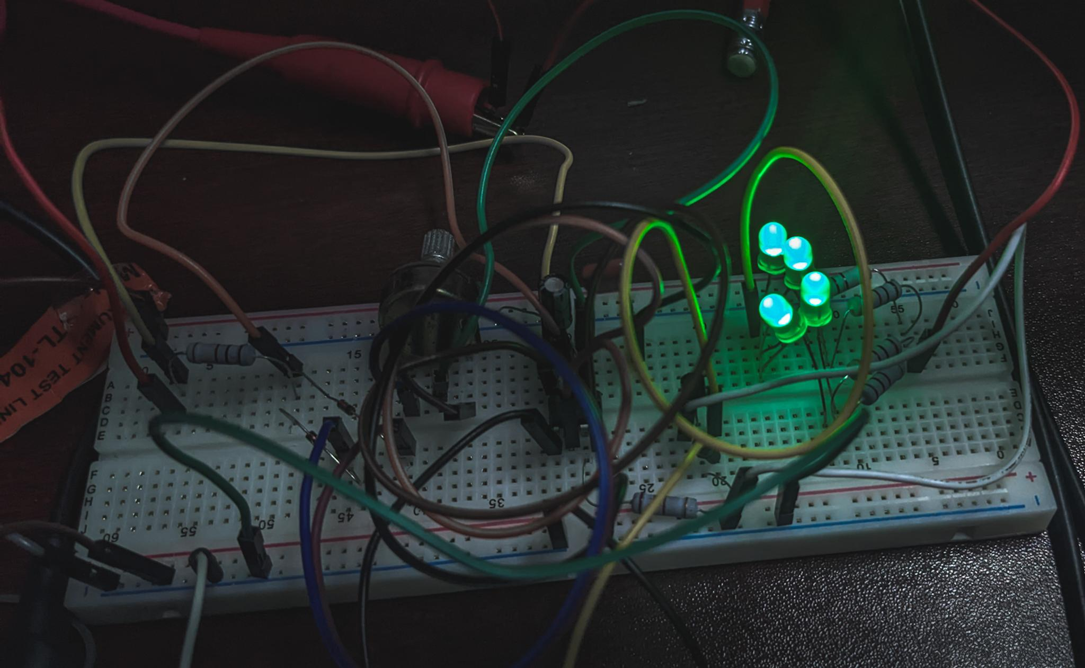
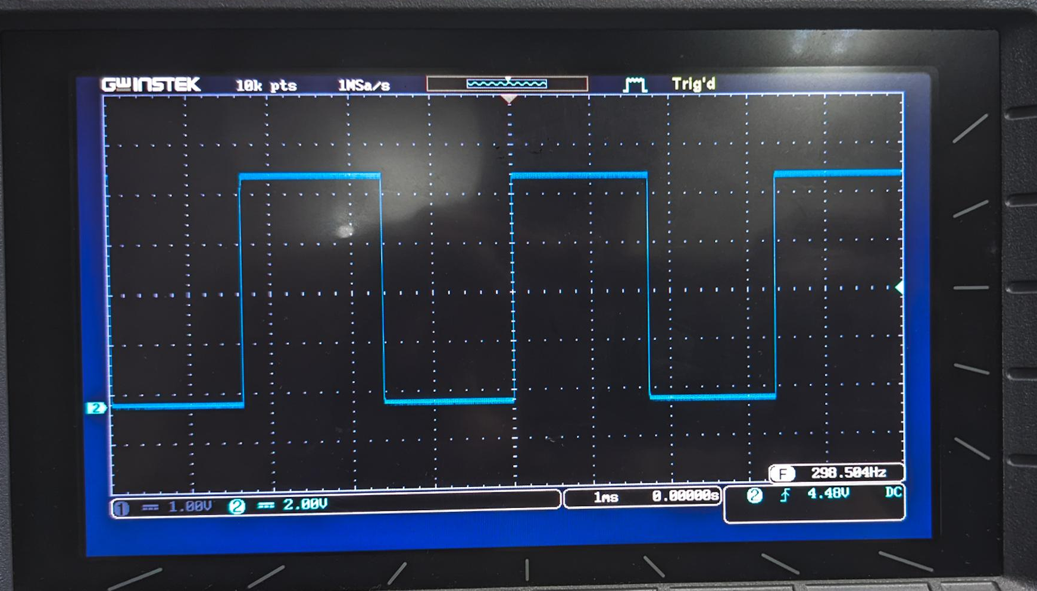
CASE 2
AVERAGE BRIGHTNESS
When _ time High voltage out of _
Diode is OPEN
LED is OFF
When _ time Low voltage out of _ T
Diode is SHORTED
LED is ON

Slide 7
CASE 2 : CALCULATIONS
Oscilloscope: Equal High V and Low V
OBSERVATIONS (POT):
PERIOD, T
2.479ms
+Width, T(o)
2.342ms
As 94.47% of time Vo= High voltage
LED is OFF majority of time
DUTY CYCLE= (T(o)/T)*100
94.47%
Left to Middle terminal
39.1 K ohm
Right to Middle terminal
0.783 K ohm
Result: We see LED is dimmed as an average result of it being ON for less time and OFF for longer

Slide 8
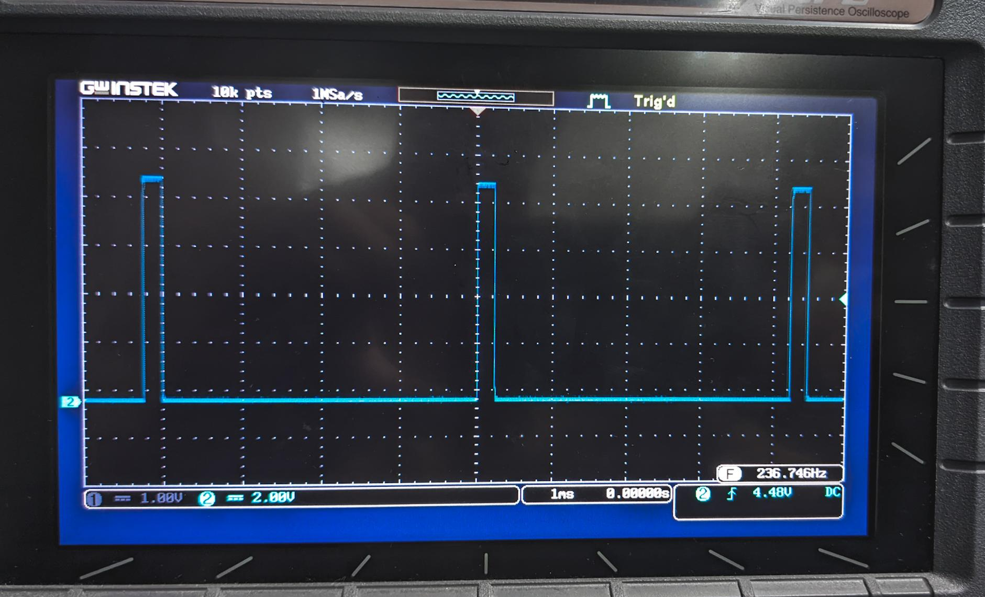
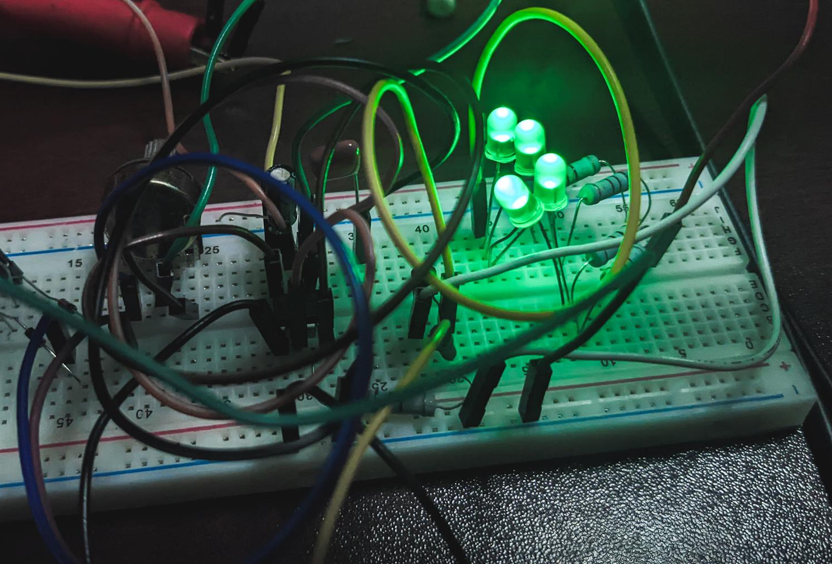
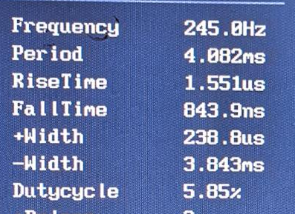
CASE 3
HIGH BRIGHTNESS
When 238.8 us time High voltage out of 4.082 ms
Diode is OPEN
LED is OFF
When 3.83 ms time Low voltage out of 4.082 ms T
Diode is SHORTED
LED is ON

Slide 9
CASE 3 : CALCULATIONS
Oscilloscope: Less High V than Low V
OBSERVATIONS (POT):
PERIOD, T
2.479ms
+Width, T(o)
2.342ms
DUTY CYCLE= (T(o)/T)*100
94.47%
As 94.47% of time Vo= High voltage
LED is OFF majority of time
Left to Middle terminal
39.1 K ohm
Right to Middle terminal
0.783 K ohm
Result: We see LED is dimmed as an average result of it being ON for less time and OFF for longer

